Slide 1

Meesho
revenue & Operational analysis
FOR THE YEAR 2023
Presented by:
SHAKTHI SIVARANJANI .R

Slide 2

Table of
CONTENTS
01 | Introduction | 05 | Data driven Insights
02 | Dataset overview | 06 | Impactful Recommendations
03 | Tools used | 07 | Conclusion
04 | Dashboard Visualization | 08 | THANK YOU

Slide 3
INTRODUCTION
This dashboard provides a comprehensive analysis of Meesho’s revenue and operational performance for the year 2023.
The objective is to identify sales trends, regional performance, and customer ordering behavior using interactive Power BI features.

Slide 4
DATASET OVERVIEW
This dataset provides a foundation for building an interactive Power BI dashboard focused on revenue, operations, and customer ordering patterns.
Meesho’s e-commerce order data for the year 2023.

Slide 5


TOOLS
USED
Excel | Power BI | Powerpoint | Demo video
Data cleaning , Preprocessing , Proper formatting | Interactive Dashboards and visualization using slicers , Drillup&down , Drillthrough & Intent designs | Meaningful and Impactful recommendations to make data driven decision . | Explaining findings & Insights .

Slide 6
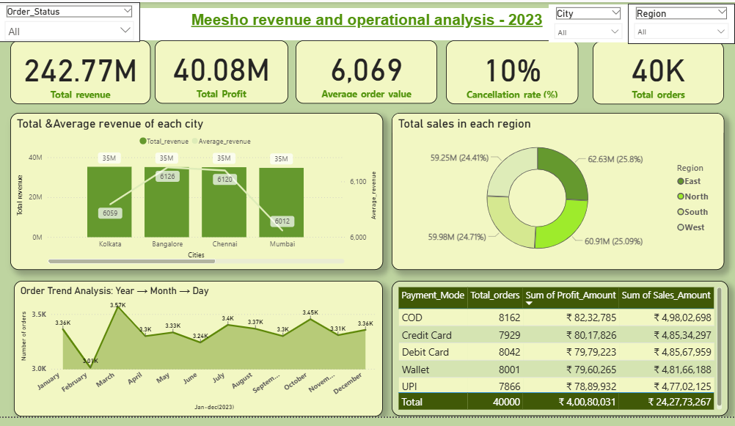
Meesho Revenue & Operation analysis -2023
In 2023, Meesho showed strong overall performance with total revenue of ₹242.77M and profit of ₹40.08M.
Customers spent an average of ₹6,069 per order, showing steady purchasing behavior. Revenue and orders are evenly spread across cities and regions, which reduces business risk.
A low cancellation rate of 10% and consistent monthly order trends indicate smooth operations and stable demand throughout the year.

Slide 7
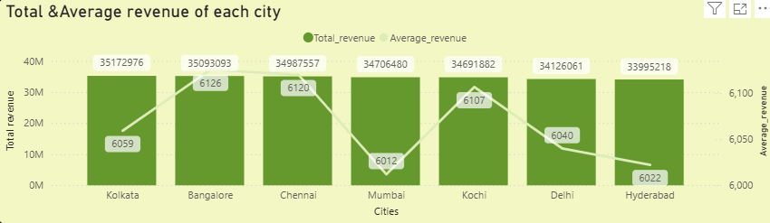

Total & Average revenue analysis
Audience Segmentation
Kolkata (3.51Cr), Bangalore(3.50Cr) and Chennai (3.49Cr) lead the story .They generate the highest total revenue, showing these cities are Meesho’s strongest and most reliable markets.
Mumbai tells a different story even with good revenue (3.47Cr), it has the lowest average order value(6,012), which suggests many small-value purchases rather than fewer big orders.
Kochi (3.46Cr) stands out quietly .It has one of the higher average order values, (6,107) indicating customers place fewer but higher value orders, making it a potential growth market.

Slide 8
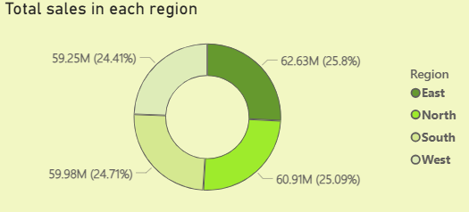
Total Sales in each region
Revenue is well balanced across all regions, with each region contributing close to 25%, showing Meesho is not dependent on a single market.
The East region slightly leads the chart(25.8%) , indicating stronger customer demand or better regional performance compared to other region .
South (24.71%) and West(24.41%) almost closely, which shows steady and consistent sales, while North (25.09%) has clear potential to grow and catch up with the top regions like east

Slide 9
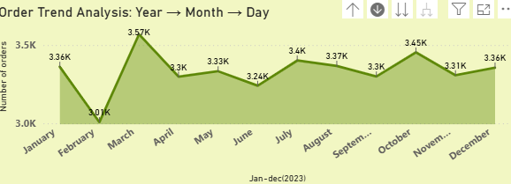
Order trend analysis : Year>Month>Day
March (3,569) & October(3,454) stand out as peak months, showing higher revenue during festive or sale-driven periods.
February (3,009) and June (3,241) showing noticeable downs, highlighting Feb & Jun months where targeted offers or promotions could help boost order volume.
Orders fluctuate through the year, showing clear ups and downs instead of a flat trend, it indicates seasonality in customer buying behavior.

Slide 10
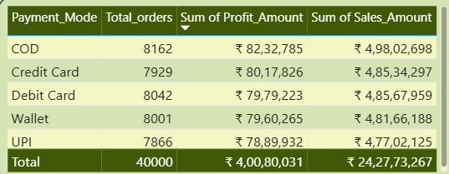
Orders, Profit & Sales in Mode of payment
COD remains the most used payment mode, generating the highest orders(8,162), sales (4.98Cr) and profit (82L) showing that many customers still prefer paying after delivery.
Digital payments UPI(4.77Cr), cards(9.71Cr) & wallets(4.81Cr) together contribute strongly, almost matching COD, which indicates growing trust in online payment options.
Profit is well distributed across all payment modes, meaning no single payment method is risky .Meesho has a healthy and balanced payment mix.

Slide 11

Recommendations
Grow more in top cities
Focusing more offers and sellers in Delhi(3.41 Cr) and Hyderabad(3.39 Cr) will increase revenue faster . Cities like Bangalore(3.50Cr), Chennai(3.49Cr), and Kolkata(3.51Cr) already give high revenue. Increase order volume in Mumbai(6,012) & Hyderabad(6,022) .These cities have good sales but lower average order value. Combo offers and discounts can help customers buy more items.

Slide 12
Recommendations
Keep all regions equally important
East , West , North & South give almost equal revenue. This shows Meesho is well balanced, so marketing should continue in every region.

Slide 13
Recommendations
Plan better for Feb & June
February(3,009) & June(3,241) showing Noticeable downs . Improving stocks , delivery & marketing should be stronger in these months . Orders are high in March(3,569) and October(3,454) .

Slide 14
Recommendations
Promote online payments slowly
COD is still popular, but UPI and cards give good profit. Small rewards can encourage customers to use online payments.

Slide 15

Drill Up
Drill down
Drill through
Slicers
Power-BI Tools
Drill-downs, drill-through, and slicers help users quickly move from overall performance to city-level or day-level details, making the dashboard more interactive and useful for faster business decisions.

Slide 16
This dashboard gives a clear view of Meesho’s revenue and order performance across cities, regions, time periods, and payment modes.
It highlights where the business is performing well and where improvements are needed, such as managing cancellations and improving weaker regions.
By using interactive features like slicers, drill-downs, and drill-through, the dashboard allows users to explore data easily and make informed, data-driven decisions.
Overall, this analysis can help Meesho improve sales planning, operational efficiency, and customer experience.
Conclusion

Slide 17


THANK YOU

